Slide 1
SOCIETY FINANCIAL MANAGEMENT
PROJECT BY :-
RAMIDI VISHNUGUPTHAA

Slide 2
CONTENTS
Introduction.
Existing System.
Drawbacks.
Proposed System.
Functional/Non functional requirements.
Frame-Work.
Scope.

Slide 3
INTRODUCTION
This Online management system will provide an interface for both the admin and for the resident.
Nowadays everything has rapidly changed. People want that their needs to be fulfilled within the circle of their comfort zone. Everyone wants to achieve more output as compared to their applied input.

Slide 4
EXISTING SYSTEM
Nowadays running system are mainly desktop based(Spreadsheet based).
These system doesn’t allow customers to interact directly.
Societies using different software for booking of plot, Billing and Accounting. Different system integration always remains a big challenge.
The strings of these systems are in the hands of admin.

Slide 5
DRAWBACKS
An impediment to reach wider audiences.
A poor customer relationship.
Poor accessibility.

Slide 6
PROPOSED SYSTEM
Housing Society Management is a Web based used to provide detailed description of payments to the residents.
It also helps residents to print their payment bill.
This web based application is implemented a Maker-Checker Operation which is more safer in transaction and keeping the records.

Slide 7
OBJECTIVE
Individualism is the belief that personal needs are more important than the needs of society as a whole. Keeping in view that belief our system will integrate the needs of both and will unburden the both(Admin, Resident).
To bring transparency in the payment details we introduce a Maker-Checker option.

Slide 8
Functional Requirements
Admin will monitor the whole system.
Resident will maintain log details of their past payments.
Maintain Record.
Remainder for the payment every month.

Slide 9
NON-FUNTIONAL REQUIREMENTS
Availability.
Reliability.
Performance.
User Friendly.
Maintainability.
Security.

Slide 10
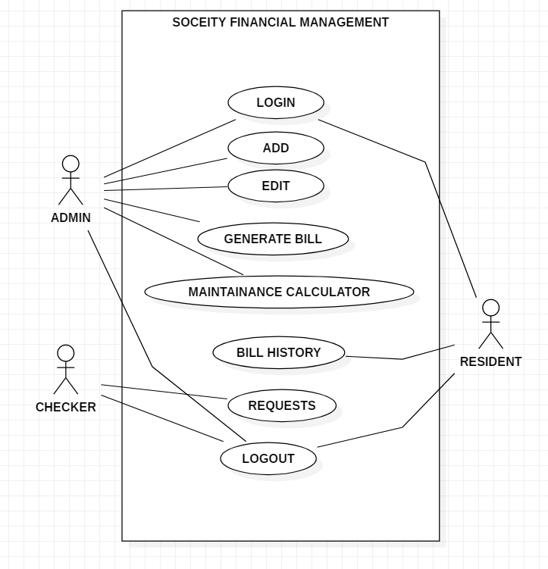

Slide 11
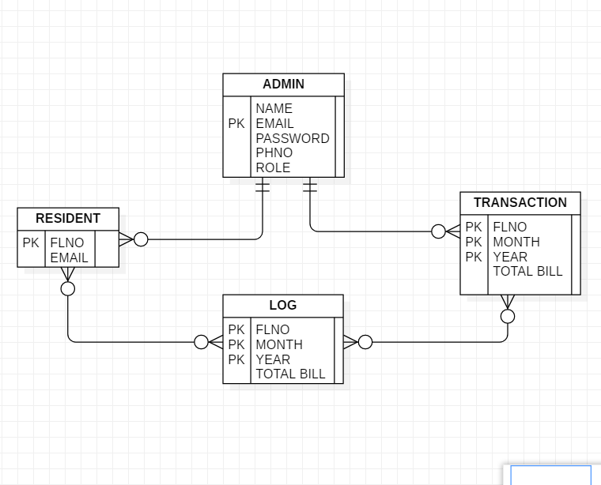
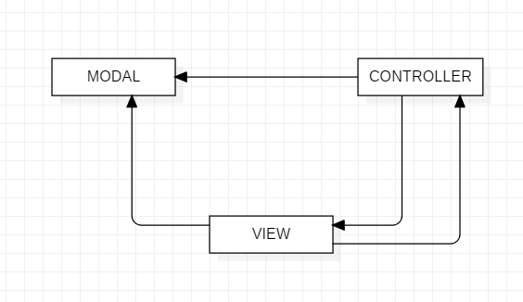
MODEL
ER DIAGRAM

Slide 12
SCOPE
Our project will enable both Admin and customer to use the functionality of the system. However for obvious reasons, Admin will be given more command than Customer
This is an online system that will provide ease to both of them. Admin can add the property easily along with its features and customer can book any property according to their requirements.
Customer can also edit its profile basic information and can view the record of the installments whether they are paid or remaining.

Slide 13

THANK YOU

